Slide 1
LESSON 09

Slide 2
Overview
of
Previous Lesson(s)

Slide 3
Over View
Typical tasks performed by lexical analyzer
Removal of white space and comments
Encode constants as tokens
Recognize keywords
Recognize identifiers
Store identifier names in a global symbol table

Slide 4
Over View..
Symbol tables are data structures that are used by compilers to hold information about source-program constructs.
Information is put into the symbol table when the declaration of an identifier is analyzed.
Entries in the symbol table contain information about an identifier such as its character string (or lexeme), its type, its position in storage, and any other relevant information.
The information is collected incrementally.

Slide 5
Over View…
Static checking refers to checks performed during compilation, whereas, dynamic checking refers to those performed at run time.
Static checking is used to insure that R-values do not appear on the LHS.

Slide 6
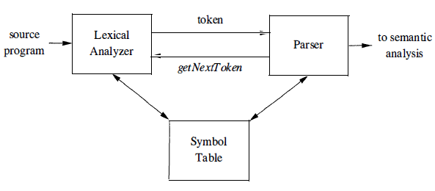
Over View…
Role of Lexical Analyzer

Slide 7
Over View…
A token is a pair consisting of a token name and an optional attribute value.
A pattern is a description of the form that the lexemes of a token may take.
In the case of a keyword as a token, the pattern is just the sequence of characters that form the keyword.
A lexeme is a sequence of characters in the source program that matches the pattern for a token and is identified by the lexical analyzer as an instance of that token.

Slide 8
Over View…
Lexical analyzer didn’t always predict errors in source code without the aid of other components.
Ex. String fi is encountered for the first time in a program in the context:
fi ( a == f (x) ) …
A lexical analyzer cannot tell whether fi is a misspelling of the keyword if or an undeclared function identifier.
fi is a valid lexeme for the token id, the lexical analyzer must return the token id to the parser and let parser in this case - handle an error due to transposition of the letters.

Slide 9
TODAY’S LESSON

Slide 10
Contents
Specification of Tokens
Strings and Languages
Operations on Languages
Regular Expressions
Regular Definitions
Extensions of Regular Expressions

Slide 11
Specification of Tokens
In this section first we need to know about finite vs infinite sets and also uses the notion of a countable set.
A countable set is either a finite set or one whose elements can be counted.
The set of rational numbers, i.e., fractions in lowest terms, is countable;.
The set of real numbers is uncountable, because it is strictly bigger, i.e., it cannot be counted.

Slide 12
Strings and Languages
For strings and languages we need to see a bunch of definitions:
Def: An alphabet is a finite set of symbols.
Ex: {0,1}, presumably φ , ascii, unicode, ebcdic
Def: A string over an alphabet is a finite sequence of symbols from that alphabet. Strings are often called words or sentences.
Ex: Strings over {0,1}: ε, 0, 1, 111010. Strings over ascii: ε, system, the string consisting of 3 blanks.

Slide 13
Strings and Languages..
Def: A language over an alphabet is a countable set of strings over the alphabet.
Ex: All grammatical English sentences with five, eight, or twelve words is a language over ascii.
Def: The concatenation of strings s and t is the string formed by appending the string t to s. It is written st.
Ex: εs = sε = s for any string s.
Def: The length of a string is the number of symbols (counting duplicates) in the string.
Ex: The length of vciit, written |vciit|, is 5.

Slide 14
Strings and Languages...
Def: A prefix of string S is any string obtained by removing zero or more symbols from the end of s.
Ex: ban, banana, and ε are prefixes of banana.
Def: A suffix of string s is any string obtained by removing zero or more symbols from the beginning of s.
Ex: nana, banana, and ε are suffixes of banana.
Def: substring of s is obtained by deleting any prefix and any suffix from s.
Ex: banana, nan, and ε are substrings of banana.

Slide 15
Strings and Languages...
Def: The proper prefixes, suffixes, and substrings of a string s are those, prefixes, suffixes, and substrings, respectively, of s that are not ε or not equal to s itself.
Ex: ban is proper prefix of banana.
Def: A subsequence of s is any string formed by deleting zero or more not necessarily consecutive positions of s.
Ex: baan is a subsequence of banana.

Slide 16
Operation on Languages
In lexical analysis, the most important operations on languages are union, concatenation, and closure, which are defined as follows:
The union of L1 and L2, written L ∪ M is simply the set-theoretic union, i.e., it consists of all words (strings) in either L1 or L2.
The union of {English sentences with one, three, or five words} with {English sentences with two or four words} is {English sentences with five or fewer words}.

Slide 17
Operation on Languages..
The concatenation of L1 and L2 is the set of all strings st, where s is a string of L1 and t is a string of L2
The concatenation of {a,b,c} and {1,2} is {a1,a2,b1,b2,c1,c2}
As with strings, it is natural to define powers of a language L L⁰={ε}, which is not φ. L^{i+1}=L^{i}L

Slide 18
Operation on Languages..
The (Kleene) closure of L, denoted L* is L⁰ ∪ L¹ ∪ L² ...
The positive closure of L, denoted L⁺ is L¹ ∪ L² ...
Ex:
{a,b}* is {ε,a,b,aa,ab,ba,bb,aaa,aab,aba,abb,baa,bab,bba,bbb,...} {a,b}⁺ is {a,b,aa,ab,ba,bb,aaa,aab,aba,abb,baa,bab,bba,bbb,...} {ε,a,b}* is {ε,a,b,aa,ab,ba,bb,...}. {ε,a,b}⁺ is the same as {ε,a,b}*.

Slide 19
Regular Expressions
A regular expression is a sequence of characters that forms a search pattern, mainly for use in pattern matching with strings.
The idea is that the regular expressions over an alphabet consist of the alphabet, and expressions using union, concatenation, and *, but it takes more words to say it right.
Each regular expression r denotes a language L(r) , which is also defined recursively from the languages denoted by r's subexpressions.

Slide 20
Regular Expressions..
Rules that define the regular expressions over some alphabet Σ and the languages that those expressions denote are:
BASIS: There are two rules that form the basis:
1. ε is a regular expression, and L(ε) is {ε} , that is, the language whose sole member is the empty string.
2. If a is a symbol in Σ, then a is a regular expression, and L(a) = {a}, that is, the language with one string, of length one, with a in its 1st position.

Slide 21
Regular Expressions...
INDUCTION: There are four parts to the induction whereby larger regular expressions are built from smaller ones.
Suppose r and s are regular expressions denoting languages L(r) and L(s), respectively.
1. (r) | (s) is a regular expression denoting the language L(r) U L(s)
2. (r) (s) is a regular expression denoting the language L(r)L(s)
3. (r)* is a regular expression denoting (L (r)) *
4. (r) is a regular expression denoting L(r)

Slide 22
Regular Expressions...
Regular expressions often contain unnecessary pairs of parentheses. We may drop certain pairs of parentheses if we adopt the conventions that:
a) The unary operator * has highest precedence and is left associative.
b) Concatenation has second highest precedence and is left associative.
c) | has lowest precedence and is left associative.

Slide 23
Regular Expressions...
Ex. Let Σ = {a, b}
The regular expression a | b denotes the language {a, b} .
(a|b)(a|b) denotes {aa, ab, ba, bb} , the language of all strings of length two over the alphabet Σ . Another regular expression for the same language is aa | ab | ba | bb
a* denotes the language consisting of all strings of zero or more a's, that is, {ε , a, aa, aaa, ... }.

Slide 24
Regular Expressions...
4. (a|b)* denotes the set of all strings consisting of zero or more instances of a or b, that is, all strings of a's and b's: {ε, a, b, aa, ab, ba, bb, aaa, ... }. Another regular expression for the same language is (a*b*)*
5. a | a*b denotes the language {a, b, ab, aab, aaab, ... }, that is, the string a and all strings consisting of zero or more a's and ending in b

Slide 25
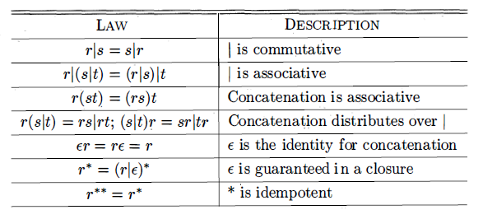
Regular Expressions...
A language that can be defined by a regular expression is called a regular set. If two regular expressions r and s denote the same regular set , we say they are equivalent and write r = s.
Algebraic Laws for regular expressions

Slide 26
Regular Definitions
If Σ is an alphabet of basic symbols, then a regular definition is a sequence of definitions of the form:
d₁ - > r₁
d₂ - > r₂
......
d_{n} - > r_{n}
Where the d's are unique and not in Σ and r_{i} is a regular expressions over Σ ∪ {d₁,...,d_{i-1}}.

Slide 27
Regular Definitions..
Ex. C identifiers can be described by the following regular definition:
letter_ → A | B | ... | Z | a | b | ... | z | _
digit → 0 | 1 | ... | 9
Id → letter_ ( letter_ | digit)*
Regular definitions are just a convenience, they add no power to regular expressions.
The C identifier example can be done simply as a regular expression by simply plugging in the earlier definitions to the later ones.

Slide 28
Extensions of RE
There are many extensions of the basic regular expressions given above.
The following three will be occasionally used in this course as they are useful for lexical analyzers.
One or more instances. This is the positive closure operator + mentioned above.
Zero or one instance. The unary postfix operator ? defined by r? = r | ε for any RE r.
Character classes. If a₁, a₂, ..., a_{n} are symbols in the alphabet, then [a₁a₂...a_{n}] = a₁ | a₂ | ... | a_{n}. In the special case where all the a's are consecutive, we can simplify the notation further to just [a₁-a_{n}].

Slide 29
Thank You

